Slide 1
PADMAPPRIYA V
71772117129
B.E. COMPUTER SCIENCE AND ENGINEERING,
GOVERNMENT COLLEGE OF TECHNOLOGY, COIMBATORE-13
3/21/2024 Annual Review

Slide 2
PROJECT TITLE
TEXT-TO-IMAGE CONVERTOR
3/21/2024 Annual Review

Slide 3


AGENDA
Problem Statement
Project Overview
End users
Solution and value proposition
Wow factor
Modelling
Result
3/21/2024 Annual Review

Slide 4

PROBLEM STATEMENT
In recent years, the field of artificial intelligence has seen significant advancements in natural language processing (NLP) and computer vision. One challenging task in this domain is generating realistic images from textual descriptions, often referred to as the text-to-image generation problem. This project aims to develop a text-to-image generator system capable of converting textual descriptions into corresponding images.
3/21/2024 Annual Review

Slide 5

PROJECT OVERVIEW
The main objective of this project is to build a robust and efficient text-to-image generator system that can accurately translate textual descriptions into visually coherent and realistic images.
The system should be capable of handling various input modalities, including structured text, unstructured text, and semantic representations.
This technology has various potential applications across multiple domains, including e-commerce, content creation, virtual reality, and more.
Especially, in content creation, such a system can assist artists and designers in visualizing their ideas quickly and efficiently.
3/21/2024 Annual Review

Slide 6

WHO ARE THE END USERS?
The text-to-image generator project can serve a wide array of users, including:
1)E-commerce Platforms: E-commerce platforms can automate product image generation from textual descriptions using the text-to-image generator.
2)Content Creators: Artists, designers, and content creators can leverage the text-to-image generator to quickly visualize their ideas and concepts.
3)Marketing and Advertising Agencies: This enables converting marketing messages into engaging images, enhancing audience engagement and attraction.
4)Virtual Reality (VR) and Augmented Reality (AR) Developers: VR and AR developers can create realistic 3D scenes and environments from textual descriptions using the text-to-image generator.
3/21/2024 Annual Review

Slide 7

YOUR SOLUTION AND ITS VALUE PROPOSITION
Solution Overview:
Our AI-driven image generation system harnesses cutting-edge deep learning and neural networks to transform plain text into stunning visuals. Using advanced techniques like diffusion models, we create photorealistic images. Whether it's portraits, landscapes, or abstract art, our platform delivers top-notch results
Value Proposition:
Hyper-realistic Imagery: Experience visuals that look lifelike.
Effortless Creation: Easily craft professional-grade images without the hassle of complex tools.
Versatile Applications: From digital art to marketing campaigns, our solution fits any project seamlessly.
Time and Cost Efficiency: Streamline your workflow and save resources with our efficient image generation process.
Consistent Excellence: Every image produced meets the highest standards, ensuring satisfaction and delight every time.
3/21/2024 Annual Review

Slide 8

THE WOW IN YOUR SOLUTION
Realism: The generated images closely resemble real-world objects, scenes, or concepts described in the text. High-fidelity visuals create a sense of immersion and believability.
Creativity: The system can generate diverse and imaginative visuals, capturing the essence of abstract or imaginative textual descriptions in visually striking ways.
Customization: Users can customize image style, color, composition, and detail to suit preferences or requirements.
User Experience: The system offers an intuitive, engaging, and seamless user experience, making text-to-image interaction enjoyable.
3/21/2024 Annual Review
8

Slide 9
MODELLING
Implemented diffusion models using PyTorch for high-quality image generation from textual prompts.
Utilization of Pandas and NumPy for efficient data handling during model training.
Access diffusion model architectures and tools from the 'diffusers' library for effective model development.
Employed pre-trained language models from Hugging Face Transformers to enhance text generation capabilities.
Visualized training metrics with Matplotlib for performance monitoring.
Leverage OpenCV for image preprocessing and post-processing tasks.
These tools collectively provide a robust framework for developing and training advanced models, empowering users to generate visually stunning images from simple text inputs.
3/21/2024 Annual Review
9

Slide 10
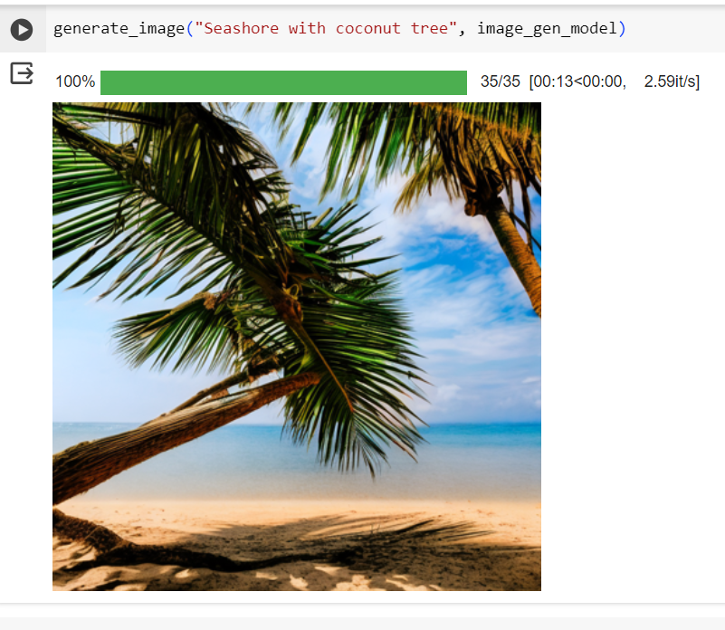
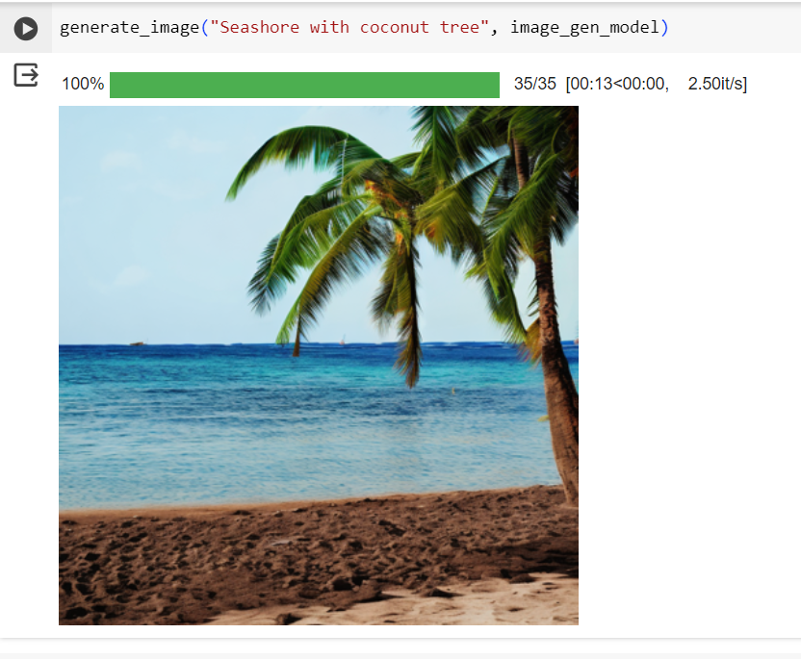
RESULTS
Users receive visually stunning images with remarkable detail and realism that suit diverse needs and preferences.
GitHub link
3/21/2024 Annual Review
10

